Slide 1
Azure Stream Analytics
Microsoft Research

Slide 2

Azure Stream Analytics
Highly scalable service for analyzing data in motion
Analyze data streaming from IoT devices and other sources
Supports SQL-like query language for data analysis
Scales easily using Streaming Units (1 SU ~= 1 MB/sec)
Event Hubs
Event Hubs
Blob Storage
IoT Hubs
Azure SQL Database
Blob Storage
Other Output Sinks
Stream Analytics
Notes:
A good way to characterize Stream Analytics is to say that a database lets you determine how many red cars were sold last year. Stream Analytics lets you determine how many red cars are in the parking lot at any given time. A great example of why it's useful to perform temporal queries on streaming data can be found at http://bit.ly/1SE5g9X ("Connected Cows").

Slide 3
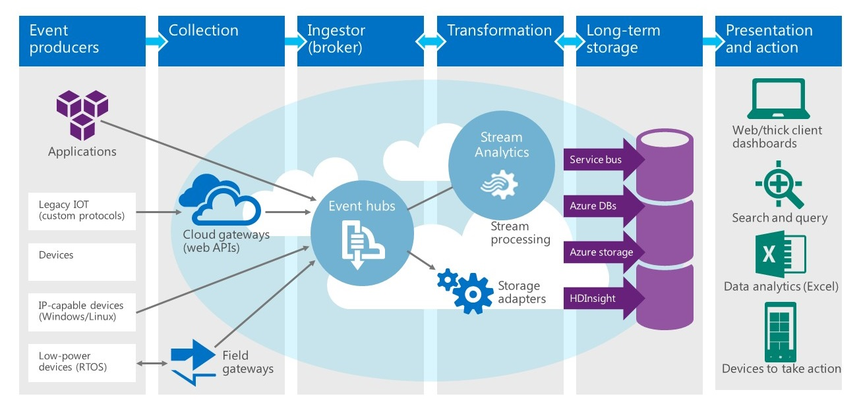
Stream Analytics at Work

Slide 4
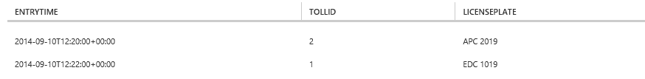
Querying a Data Stream
SELECT EntryTime, TollId, LicensePlate
FROM EntryData
WHERE Make = 'Honda' AND State = 'NJ'
Notes:
This query lists the license plate numbers of all Honda cars with NJ license plates that have entered a toll booth.

Slide 5
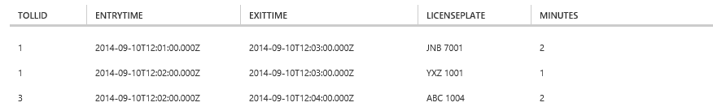
JOINing Two Data Streams
SELECT EN.TollId, EN.EntryTime, EX.ExitTime, EN.LicensePlate,
DATEDIFF(minute, EN.EntryTime, EX.ExitTime) AS Minutes
FROM EntryData EN TIMESTAMP BY EntryTime
JOIN ExitData EX TIMESTAMP BY ExitTime
ON EN.TollId = EX.TollId
AND EN.LicensePlate = EX.LicensePlate
AND DATEDIFF(minute, EN, EX) BETWEEN 0 AND 15
Notes:
This query determines how long it took to service each car that entered a toll booth (i.e., the difference between the time the car entered and exited the toll both). And it demonstrates the use of the all-important TIMESTAMP BY extension, which allows you to designate a field in the input as the event time. Without TIMESTAMP BY, the event time is the time at which the event arrived at the input source.

Slide 6
Windowing
Core requirement for stream-processing systems for grouping events into fixed-length periods of time
Tumbling Window
Hopping Window
Sliding Window
Notes:
TumblingWindow allows you to ask questions such as "How many red cars go through my toll booths every 5 minutes?" SlidingWindow lets you ask "During which 5-minute time periods do 10 or more red cars go through my toll booths?"

Slide 7
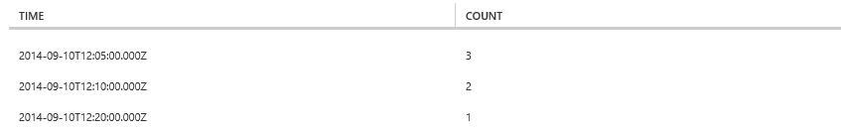
Using TumblingWindow
SELECT System.Timestamp AS Time, COUNT(*)
FROM EntryData TIMESTAMP BY EntryTime
WHERE TollId = 1 AND State = 'NY'
GROUP BY TumblingWindow(minute,5)
Notes:
This query answers the question "how many cars with NY license plates enter toll booth #1 every 5 minutes?"

Slide 8
Using SlidingWindow
SELECT DateAdd(minute,-5,System.TimeStamp) AS [Start Time],
System.TimeStamp AS [End Time], TollId, COUNT(*)
FROM EntryData TIMESTAMP BY EntryTime
WHERE State = 'NJ'
GROUP BY TollId, SlidingWindow(minute, 5)
HAVING COUNT(*) > 1
Notes:
This query answers the question "which toll booths have served two or more cars with NJ license plates in a 5-minute period?"

Slide 9
Hands-On Lab
IoT and Azure Stream Analytics
Azure Stream Analytics HOL.html

